Slide 1
autocorrect.Speller()
Yan Jin
3036021359
MFFinTech

Slide 2
What is it?
A third-party library aiming at providing spelling correction on multiple languages.
Supporting 12 Indo-European languages, and extendable.
Based on regular expression matching and probabilistic modelling.

Slide 3
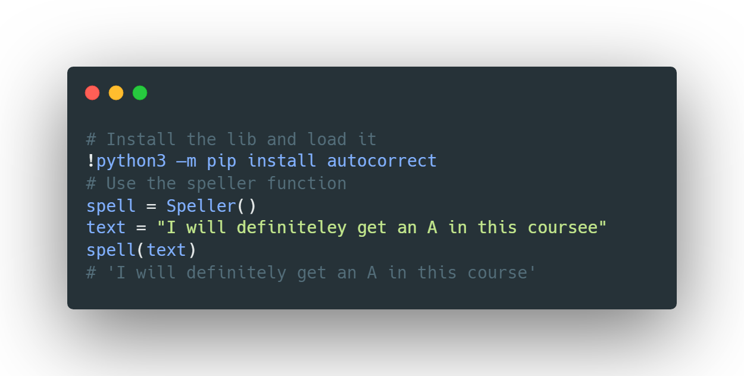
How to use it?

Slide 4
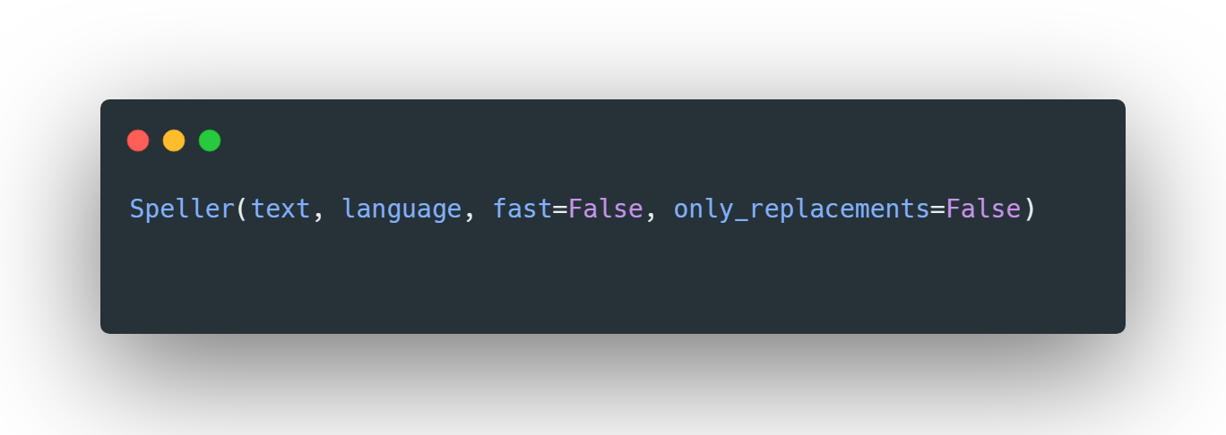
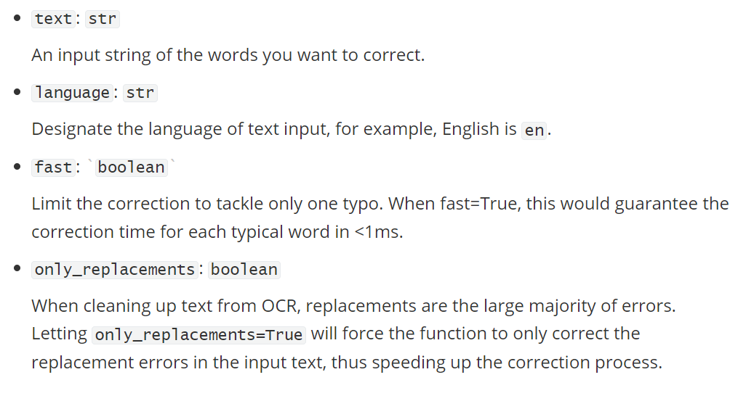
Function Details

Slide 5
Renference
https://github.com/filyp/autocorrect
https://norvig.com/spell-correct.html
https://github.com/phatpiglet/autocorrect

